Slide 1

Modeling and Simulating Multiphysics Systems with Discrete Exterior Calculus
Ft. Worth, TX
03/07/25
James Fairbanks, Luke Morris, George Rauta

Slide 2
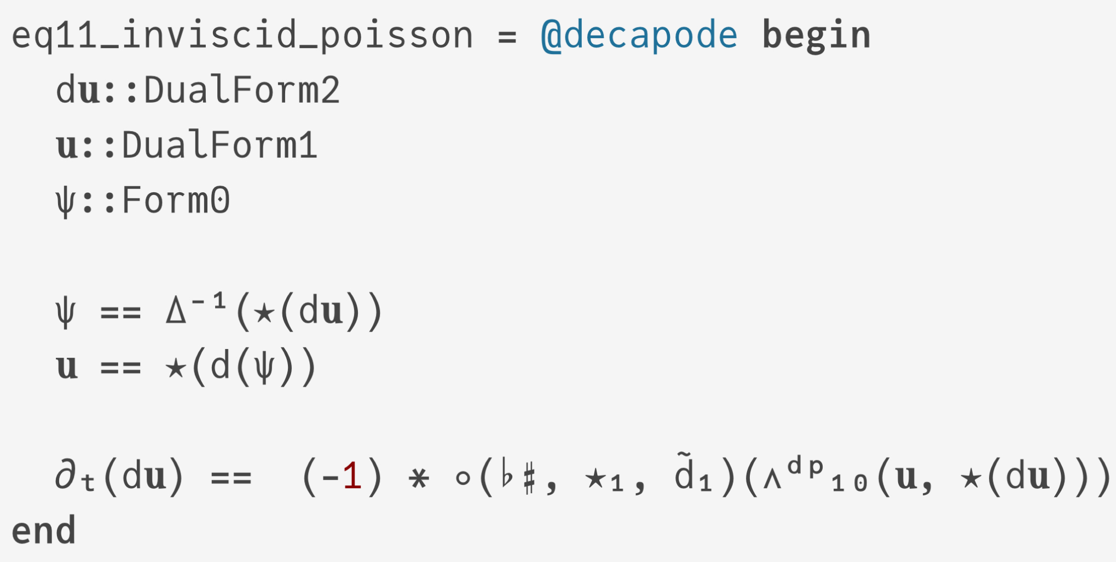
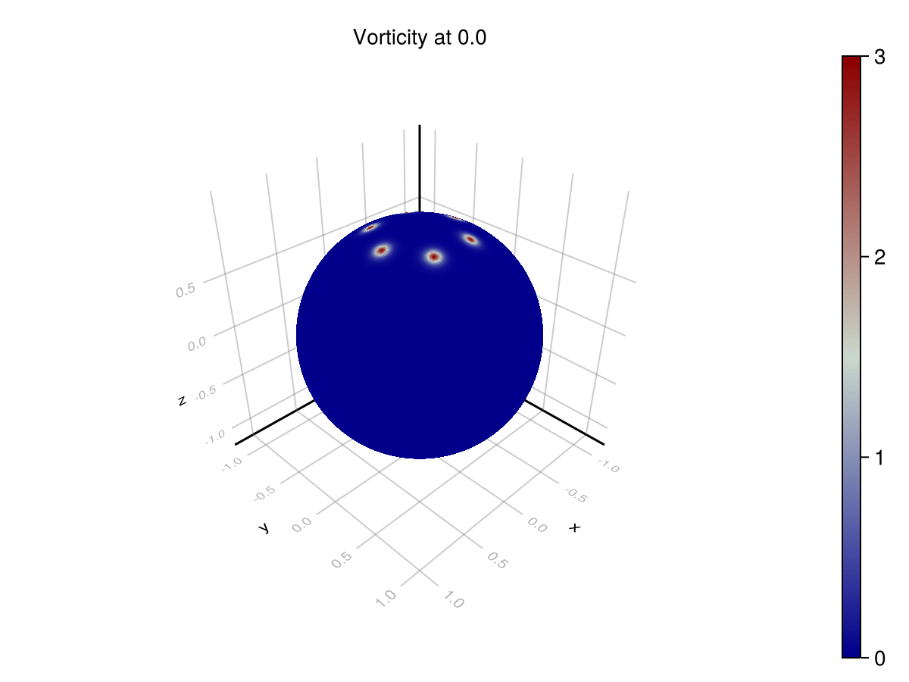
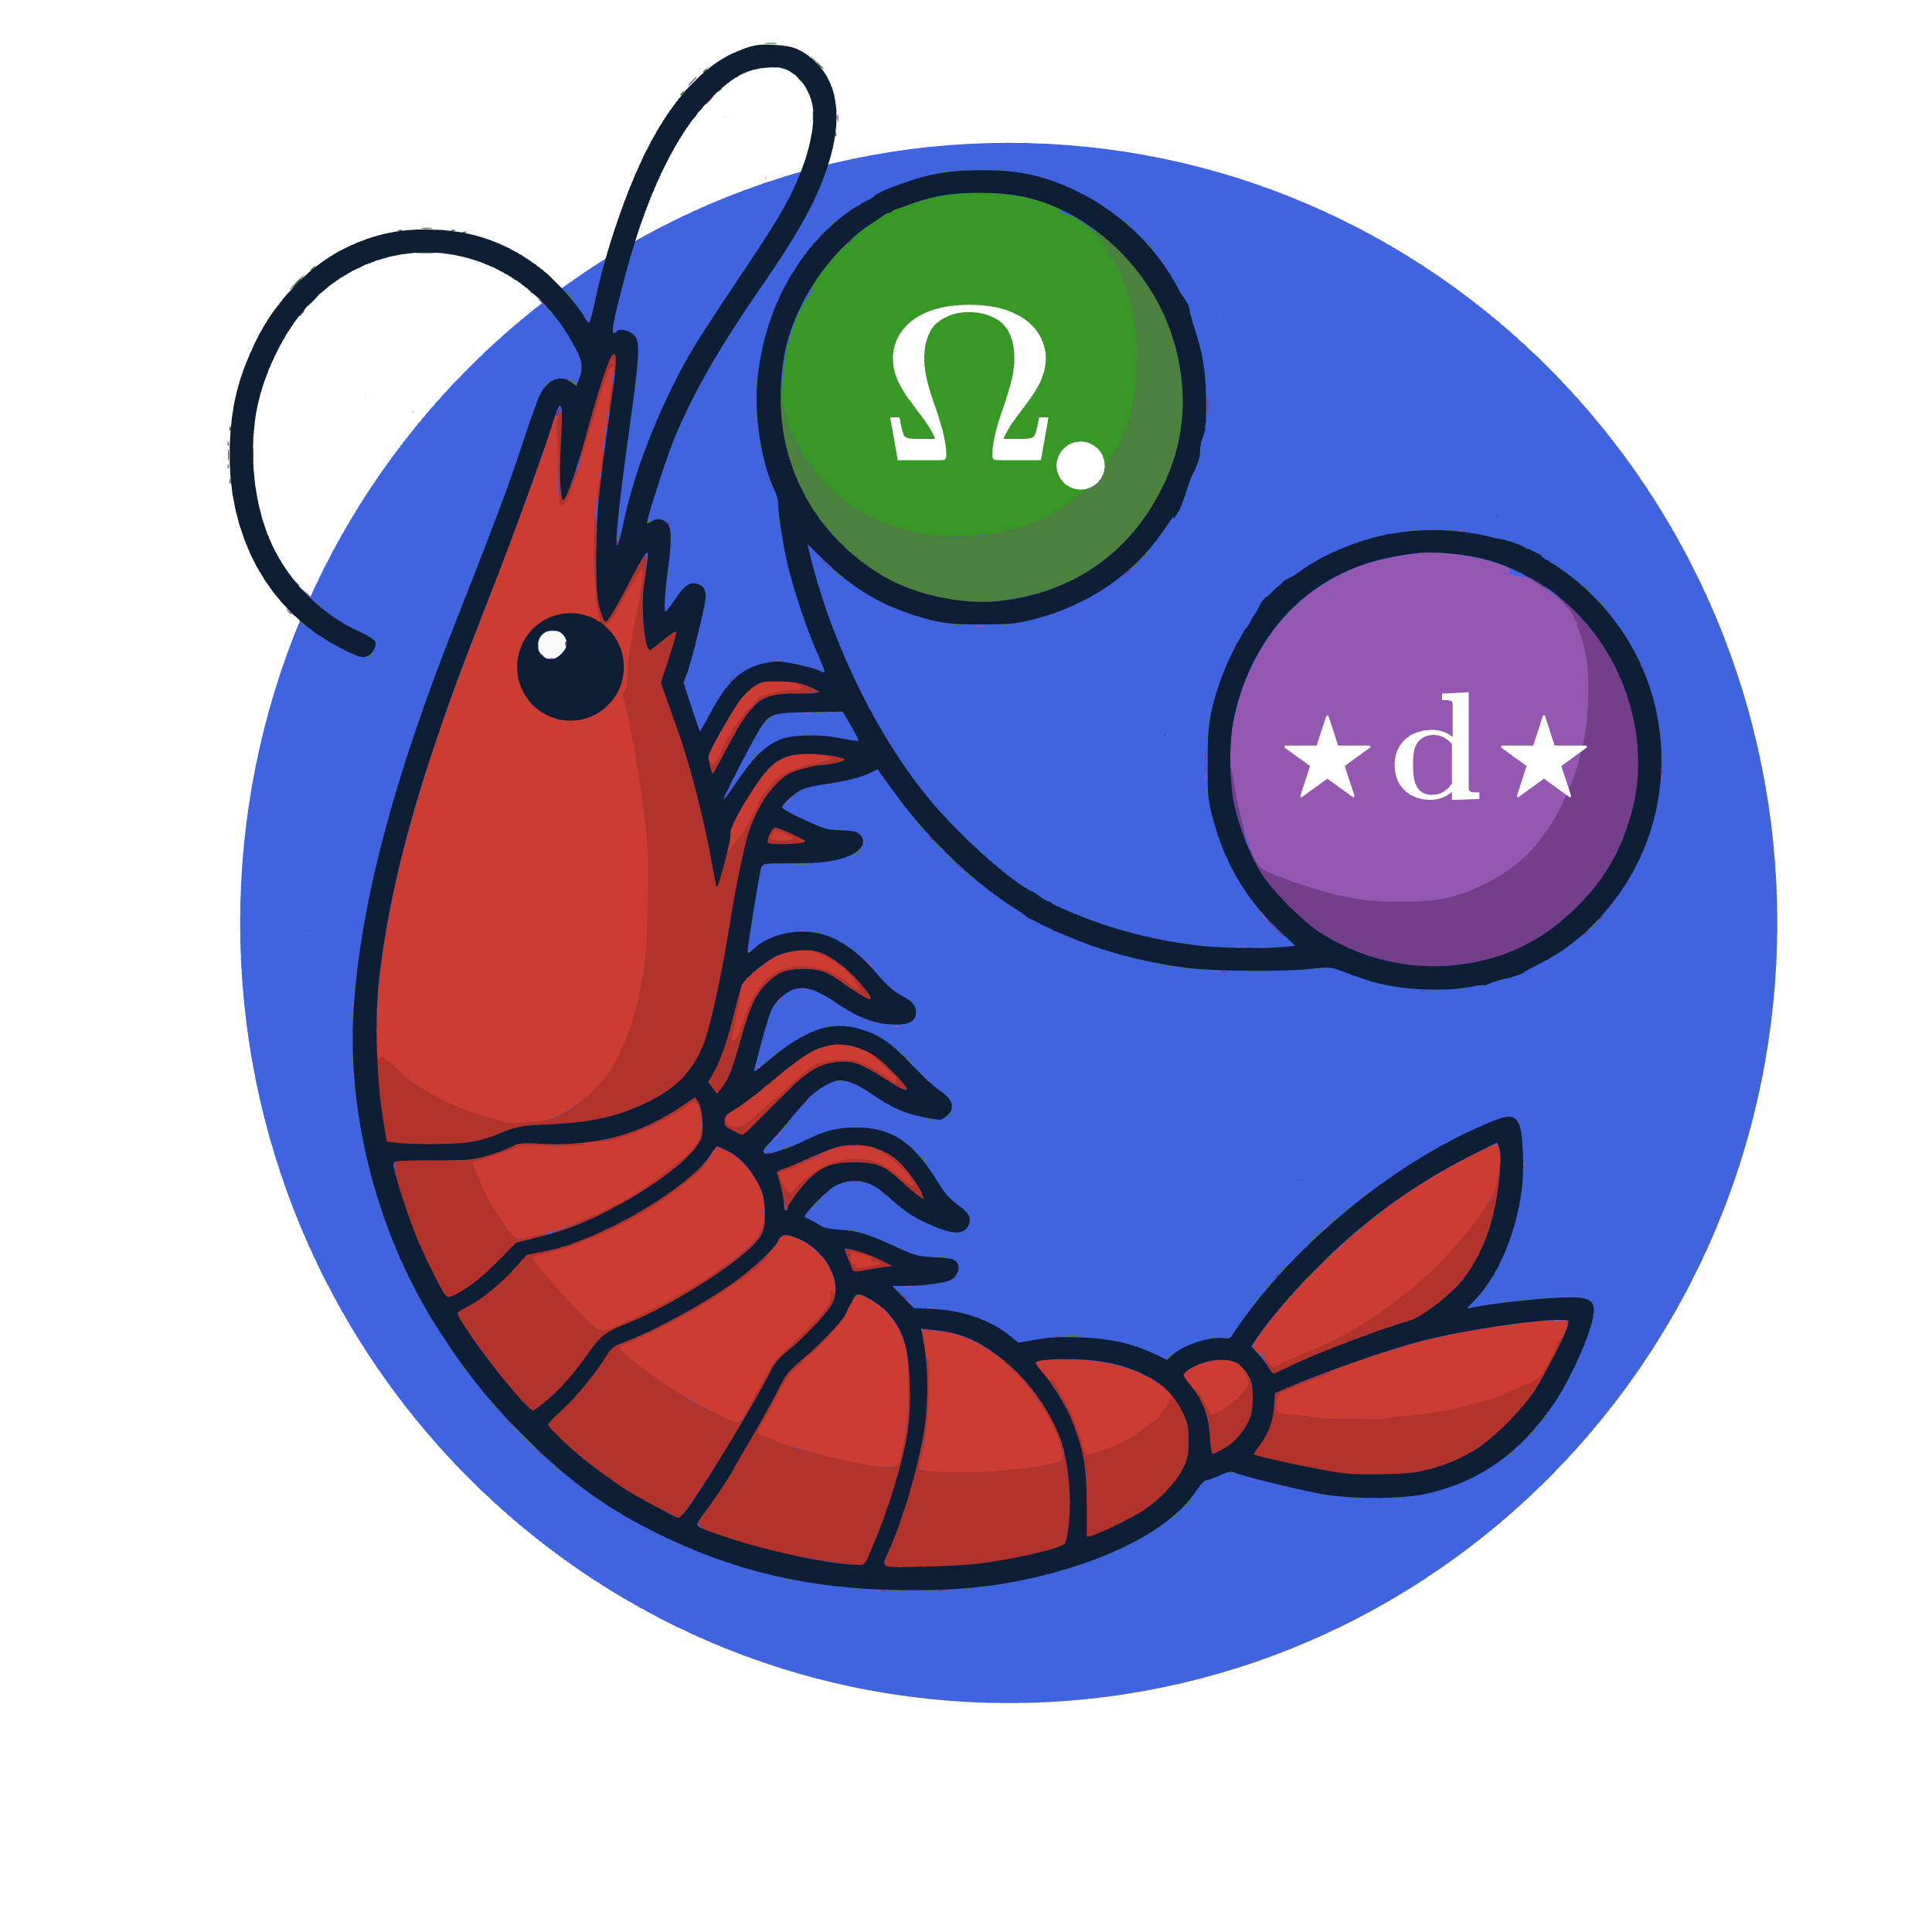
DECAPODES: A Framework for Directly Computable Physics
Decapodes.jl Simulation
Notes:
The DECAPODES software platform uses Exterior Calculus, a novel approach to the mathematics of shape and quantity to support simulation software that is easier to user, faster, and more accurate than existing approaches. This software solves problems in physics, chemistry, biology, and engineering.
Funded by: DARPA Defense Science Office PM Jan Vandenbrande / LTC David Lewis, Information Innovation Office Joshua Elliot / Erica Briscoe, DSO Young Faculty Award
Potential Funders: Navy Research Lab – Stennis, MS, Army Research Lab Adelphi, MD, Air Force Research Lab – Rome NY in program development pipeline
Impacts: We have developed a state-of-the-art software platform that is ready for a transition to research and development programs with the service labs to solve their computational problems.

Slide 3
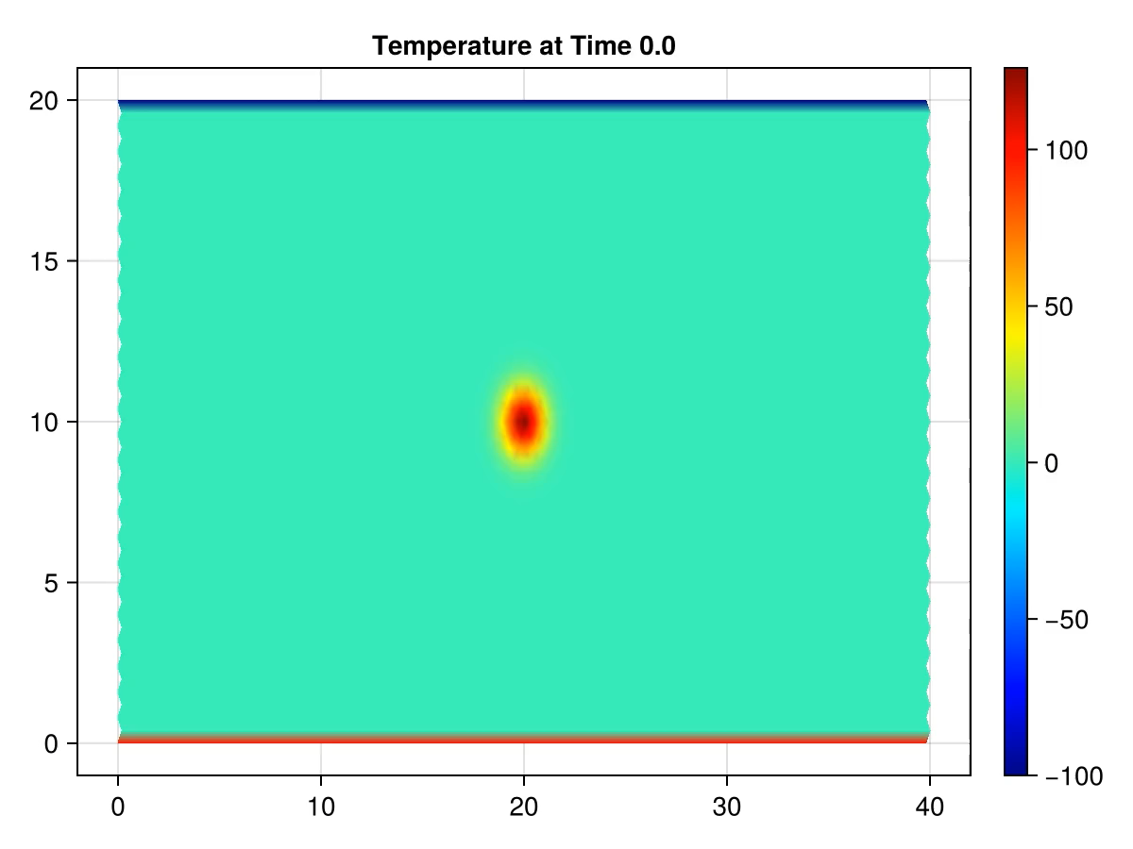
Porous Convection: Darcy + Boussinesq
Porous_Convection = @decapode begin
(λ_ρ₀Cp, αρ₀, k_ηf, ϕ)::Constant
(P, T, Adv, bound_T, bound_Ṫ)::Form0
(g, qD)::Form1
bound_T == adiabatic(T)
# Darcy flux
ρ == g ∧ (αρ₀ * bound_T)
P == Δ⁻¹(δ(ρ))
qD == -(k_ηf * (d(P) - ρ))
Adv == ⋆(interpolate(∧ᵈᵖ₁₁(⋆(d(bound_T)), qD)))
Ṫ == -1/ϕ * Adv + λ_ρ₀Cp * Δ(bound_T)
bound_Ṫ == tb_bc(Ṫ)
∂ₜ(T) == bound_Ṫ
end
Entire Specificaytion of physics above
Divergence-free condition on pressure field enforced by pressure projection method
Top/bottom temperature conditions and adiabatic side conditions
Notes:
Simulation and constants taken from https://pde-on-gpu.vaw.ethz.ch/lecture4/#exercise_1_thermal_porous_convection_in_2d

Slide 4
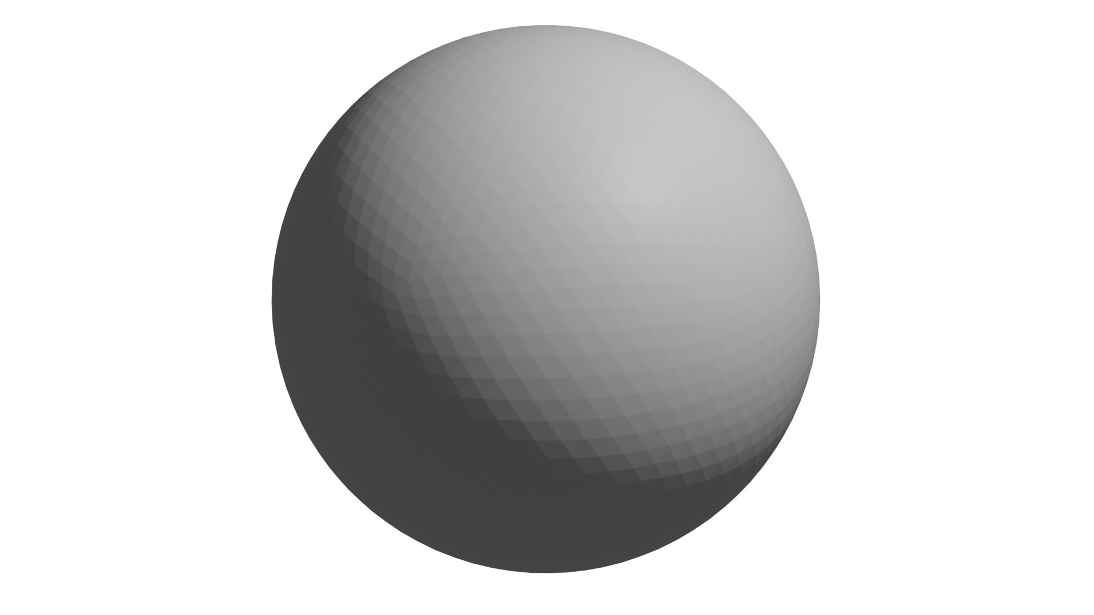
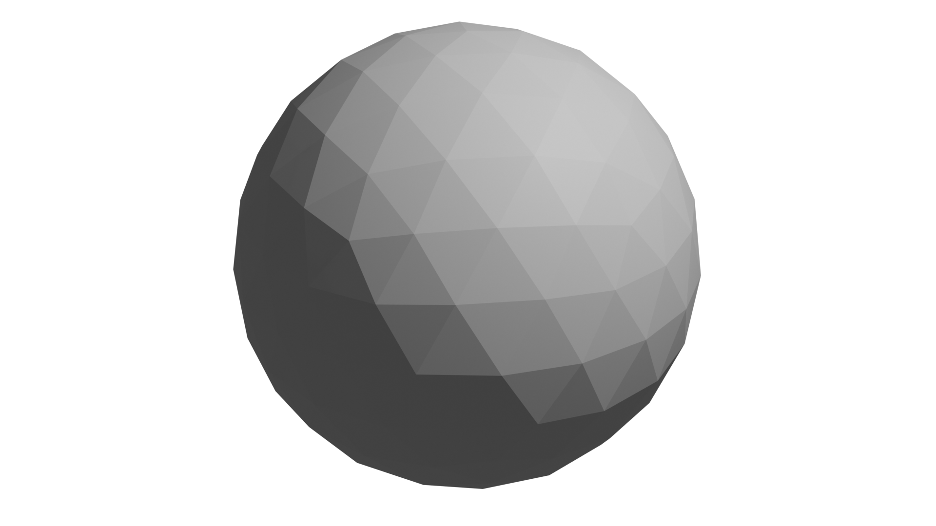
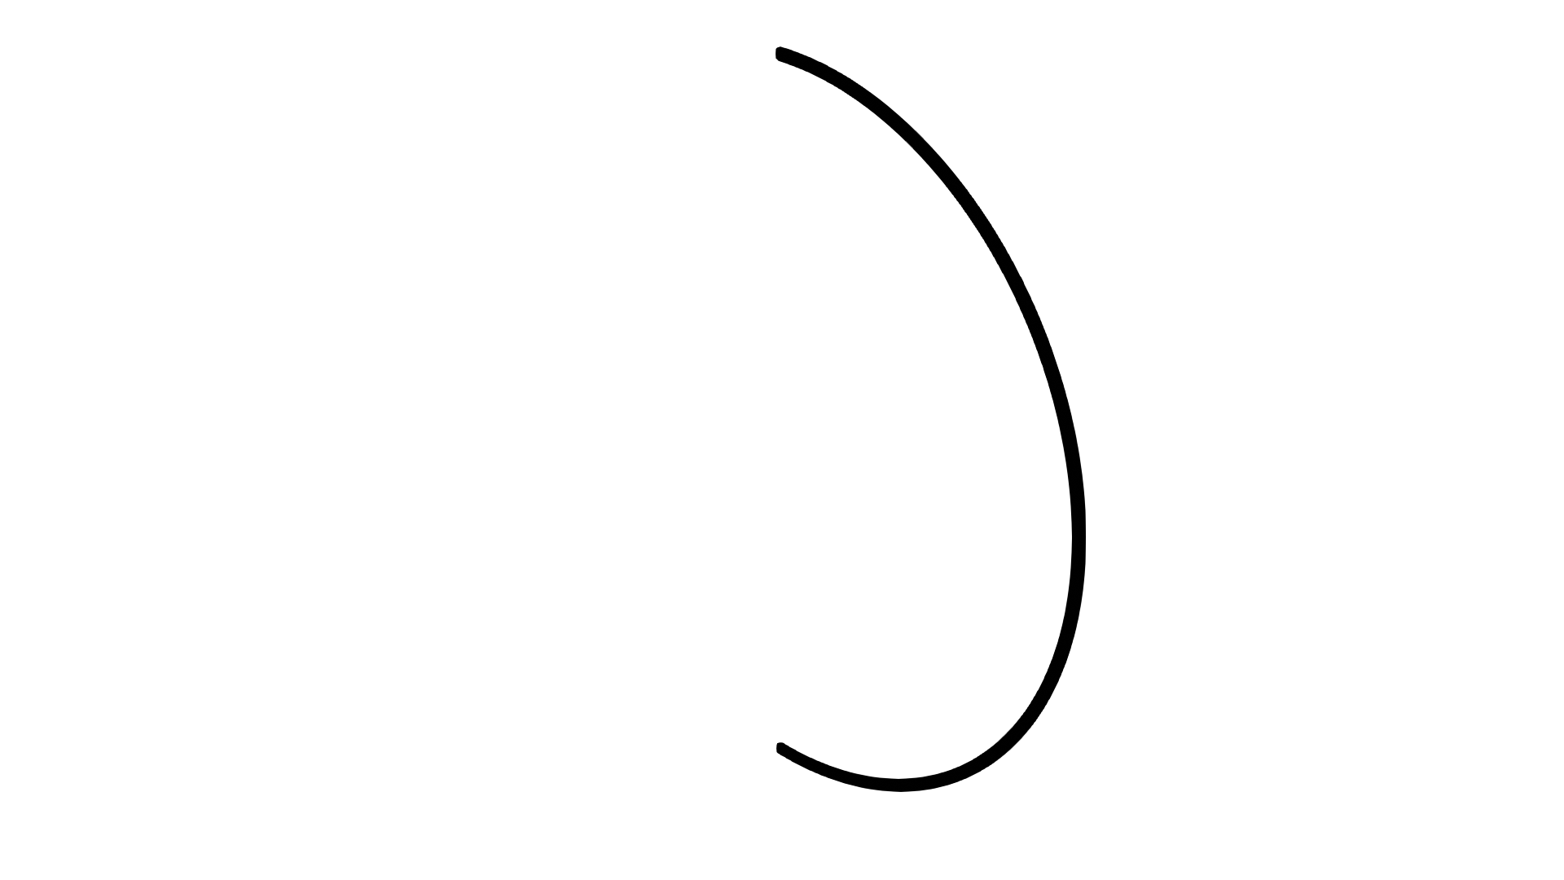
M3P: Multidomain, Multiscale, Multiphysics
Multiphysics: composing physical laws
Multiscale: need multiple grid with different resolutions
Multidomain: complex scenarios need different physics on different domains
Interface

Slide 5
Vector Calculus Diagrams
Diffusion: Laplacian Formulation
Scalar and vector fields are the objects
Differential operators Div, Grad, Curl are arrows
Allow functions (f/k) on scalar/vector fields too
Diffusion: Fick’s Law Formulation
Notes:
Semi-Simplicial Sets capture the combinatorial aspects of a geometric object
CombinatorialSpaces.jl supports coordinates and orientations, which are necessary for DEC
Uses a generic implementation predating our adoption of Simplicial Meshes

Slide 6
Physical Principles in Vector Calculus
Fick’s Law of Diffusion
Scalar Transport by Advection
Conservation of Mass
Superposition of Flux
Notes:
Semi-Simplicial Sets capture the combinatorial aspects of a geometric object
CombinatorialSpaces.jl supports coordinates and orientations, which are necessary for DEC
Uses a generic implementation predating our adoption of Simplicial Meshes

Slide 7
Building Multiphysics with Wiring Diagrams
Junctions are Variable : Domain
Boxes are subsystem (component physics)
Ports are exposed variables in the subsystems
Wires connect ports to junctions with matching domains
Outer Ports allow hierarchy by exposing variables of the composite system to next level of hierarchy
Notes:
Semi-Simplicial Sets capture the combinatorial aspects of a geometric object
CombinatorialSpaces.jl supports coordinates and orientations, which are necessary for DEC
Uses a generic implementation predating our adoption of Simplicial Meshes

Slide 8
Advection Diffusion Multiphysics Model
Notes:
Semi-Simplicial Sets capture the combinatorial aspects of a geometric object
CombinatorialSpaces.jl supports coordinates and orientations, which are necessary for DEC
Uses a generic implementation predating our adoption of Simplicial Meshes

Slide 9
M3P: Multidomain, Multiscale, Multiphysics
Multiphysics: composing physical laws
Multiscale: need multiple grid with different resolutions
Multidomain: complex scenarios need different physics on different domains
Interface

Slide 10
Functoriality of De Rahm Complex
Continuous maps between spaces induce pushforwards and pullbacks of forms
Discretized: Geometric Morphisms of Simplicial Sets induce prolongation and relaxation linear maps
Multigrid!

Slide 11
Geometric Multigrid Using Generic Subdivision
Notes:
Binary, Cubic Subdivision schemes
Illustration of Geometric Morphism points embedded into interiors of simplices
Convergence plots showing that both work (at same resolution, same convergence)

Slide 12
Convergence Results
Decapodes supports arbitrary geometric maps for the levels of the multigrid
Binary and Cubic subdivision schemes behave well on our test problems
Notes:
TODO: update this figure with relative residual, add similar plot for binary subdivision
s = triangulated_grid(1,1,1/4,sqrt(3)/2*1/4,Point3D,false)
function plot_residuals(s; cycles=1:50, timeit=false)
i = 0
function residuals(scheme::AbstractSubdivisionScheme, level, sizes)
series = PrimalGeometricMapSeries(s, scheme, level);
md = MGData(series, sd -> ∇²(0, sd), 3, scheme)
sd = finest_mesh(series)
push!(sizes, nv(sd))
L = first(md.operators)
b = L*rand(nv(sd)) #put into range of the Laplacian for solvability
u0 = zeros(nv(sd))
ress = map(cycles) do cyc
if timeit
# 2[schemes] * 3[levels'] * 50[cycles'] = 300[trials]
@info i
i += 1
@elapsed u = multigrid_vcycles(u0,b,md,cyc)
else
u = multigrid_vcycles(u0,b,md,cyc)
norm(L*u-b)/norm(b)
end
end
end
bin_sizes = []
bin_ress = map(lev -> residuals(BinarySubdivision(), lev, bin_sizes), 2:4)
cub_sizes = []
cub_ress = map(lev -> residuals(CubicSubdivision(), lev, cub_sizes), 2:4)
f = Figure()
ax = CairoMakie.Axis(f[1,1];
title = "Multigrid V-cycles",
yscale = timeit ? identity : log10,
ylabel = timeit ? "execution time [s]" : "log₁₀(relative error)",
xlabel = "# cycles")
colors = [:blue, :green, :orange]
for lev in 1:3
lines!(ax, bin_ress[lev],
label="binary, $(lev+1) levels, $(bin_sizes[lev]) vertices",
linestyle=:solid, color=colors[lev])
lines!(ax, cub_ress[lev],
label="cubic, $(lev+1) levels, $(cub_sizes[lev]) vertices",
linestyle=:dash, color=colors[lev])
end
f[1,2] = Legend(f,ax,"Scheme")
f
end
plot_residuals(s, timeit=true)

Slide 13
Runtime Improvement in Upstream Solvers
Levels | Direct Factorization (LU) |  | CG with ILU0 |  | Multigrid |  | CG w/ Multigrid
7 | 0.858 s | 5.369e-16 | 8.27 s | 1.484e-9 | 2.76 s | 4.130e-9 | 4.44 s | 6.193e-10
6 | ~ | ~ | ~ | ~ | 3.05 s | 7.508e-8 | 8.60 s | 1.020e-10
5 | ~ | ~ | ~ | ~ | 2.48 s | 1.862e-7 | 11.9 s | 5.564e-10
4 | ~ | ~ | ~ | ~ | 2.38 s | 2.153e-7 | 22.3 s | 1.104e-9
NV = 2,362,369, Sparsity: ~7 nnz/row
Direct Factorization: LU took 39.854 seconds and 6.72 GiB
CG with ILU0: factorization took 47.260 seconds and 17.60 GiB
Multigrid: (5 w-cycles, 3 steps of (pre/post)smoothing)
CG Multigrid: (2 w-cycles, 3 steps of (pre/post)smoothing)
Notes:
LU factors together are a magnitude denser than the original matrix, sparsity is ~186.7)
ILU From KrylovPreconditioners.jl,

Slide 14
M3P: Multidomain, Multiscale, Multiphysics
Multiphysics: composing physical laws
Multiscale: need multiple grid with different resolutions
Multidomain: complex scenarios need different physics on different domains
Interface

Slide 15
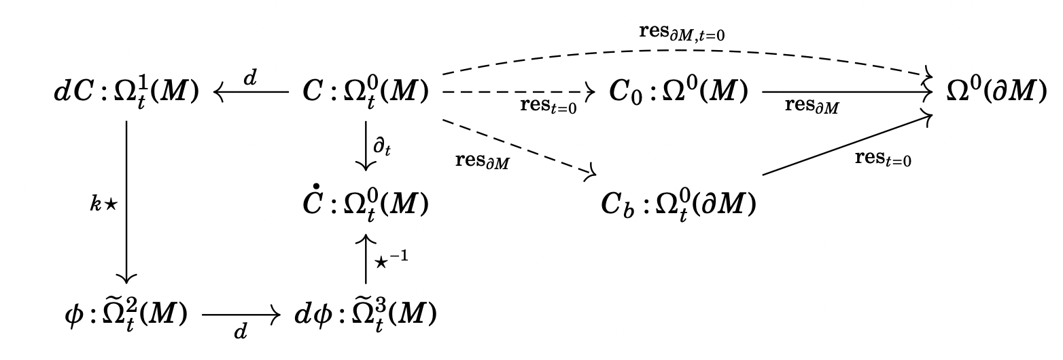
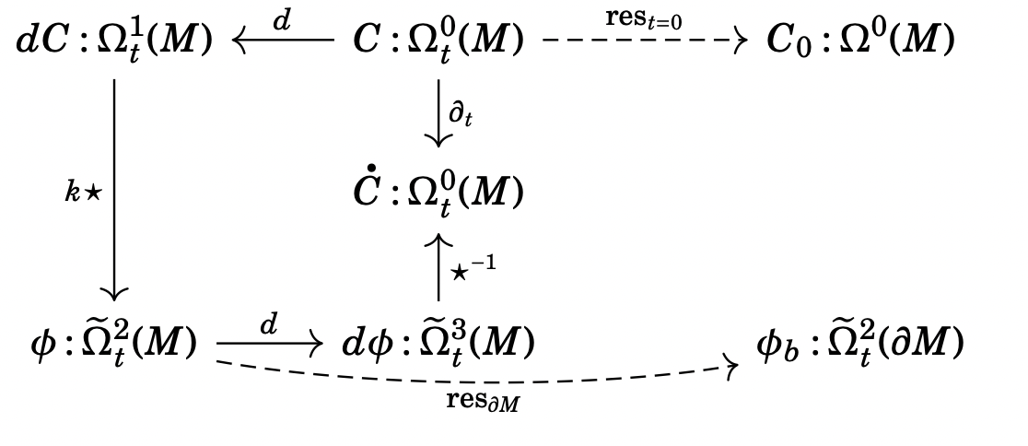
Boundary Conditions
Neumann
Dirichlet
Morphisms between manifolds (like the boundary operator) induce relationships between diagrams.
Can enforce boundary and initial conditions in the same framework

Slide 16
GPU Implementation
Most DEC operators are sparse matrices. (d, δ, Δ, etc.)
Hodge star (★) is diagonal
Wedge products (∧) are rank 2 tensors, implemented as custom kernels done with KernelAbstractions.jl.
All other operators, like the Lie Derivative are combinations of these basic operators
@kernel function wedge_kernel_11!(res, @Const(α), @Const(β), @Const(e), @Const(c))
i = @index(Global)
e0, e1, e2 = e[Int32(1), i], e[Int32(2), i], e[Int32(3), i]
c1, c2, c3 = c[Int32(1), i], c[Int32(2), i], c[Int32(3), i]
ae0, ae1, ae2 = α[e0], α[e1], α[e2]
be0, be1, be2 = β[e0], β[e1], β[e2]
@inbounds res[i] = (c1 * (ae2 * be1 - ae1 * be2) + c2 * (ae2 * be0 - ae0 * be2) + c3 * (ae1 * be0 - ae0 * be1))
end

Slide 17
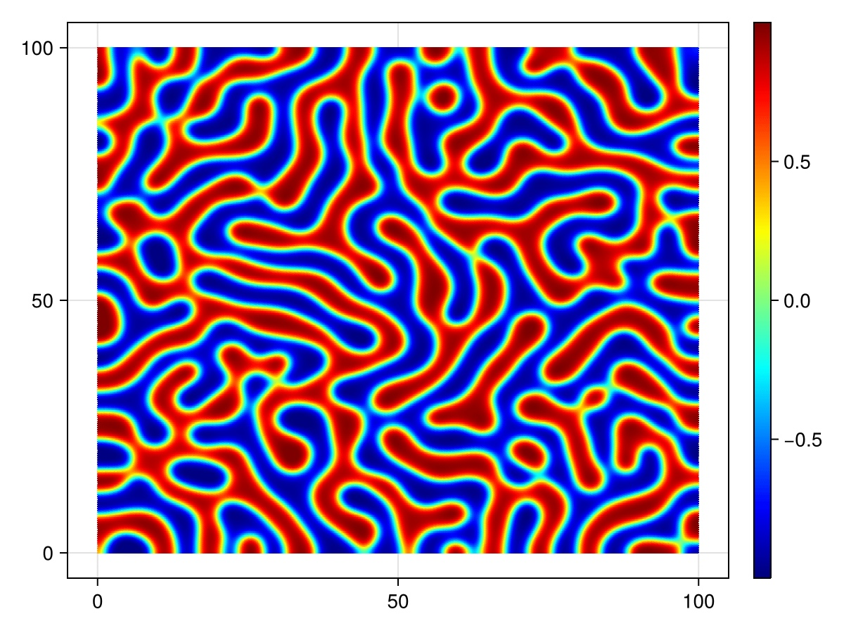
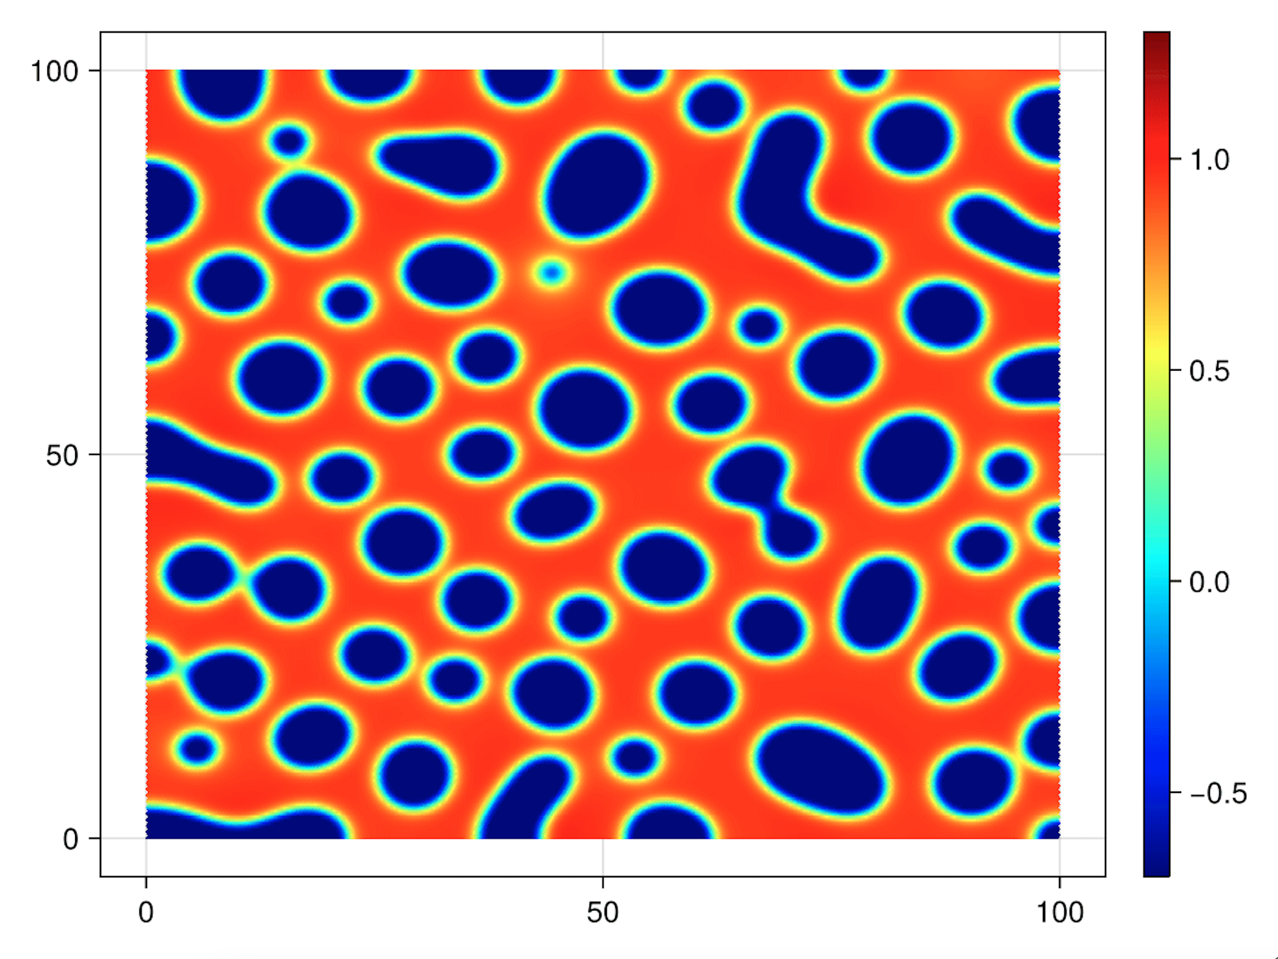
GPU Implementation
CahnHilliard = @decapode begin
C::Form0
(D, γ)::Constant
∂ₜ(C) ==
D * Δ(C.^3 - C - γ * Δ(C))
end
Mesh Size (Vertices) | CPU Time (s) | GPU Time (s) | Speedup (CPU/GPU)
58,081 (1) | 2.772 | 0.497 | ~5.58X
90,601 (0.8) | 8.463 | 1.074 | ~7.88X
160,801 (0.6) | 48.313 | 2.943 | ~16.42X
231,361 (0.5) | 139.489 | 6.122 | ~22.78X
361,201 (0.4) | 532.123 | 15.266 | ~34.86X
32 CPU Threads AMD Processor vs A100 GPU
Notes:
Last row of table was 641,601 (0.3) N/A 51.993
Triangulated grid 240x240 with increasing spatial resolution,
save results at every 0.2 timestep,
go for 100 time units,
Float32,
AMD EPYC 7702 64-Core Processor at 32 threads,
A100-SXM-80GB

Slide 18
Vorticity Formulation of Incomp. Navier Stokes
Decapodes doesn’t know any physics or fancy CFD tricks
Just Vanilla DEC + General Purpose Compute Graphs
Representation is flexible enough to capture equational rewrites
Naïve Formulation
UNSTABLE
Pressure Projection Formulation
STABLE
eq11_incorrect = @decapode begin
d𝐮::DualForm2
𝐮::DualForm1
𝐮 == d₁⁻¹(d𝐮) ∂ₜ(d𝐮) == -1 ∘(♭♯, ⋆₁, d̃₁)(∧ᵈᵖ₁₀(𝐮, ⋆(d𝐮)))
end
eq11_inviscid_poisson = @decapode begin
d𝐮::DualForm2
𝐮::DualForm1
ψ::Form0
ψ == Δ⁻¹(⋆(d𝐮))
𝐮 == ⋆(d(ψ))
∂ₜ(d𝐮) == -1∘(♭♯, ⋆₁, d̃₁)(∧ᵈᵖ₁₀(𝐮, ⋆(d𝐮)))
end

Slide 19
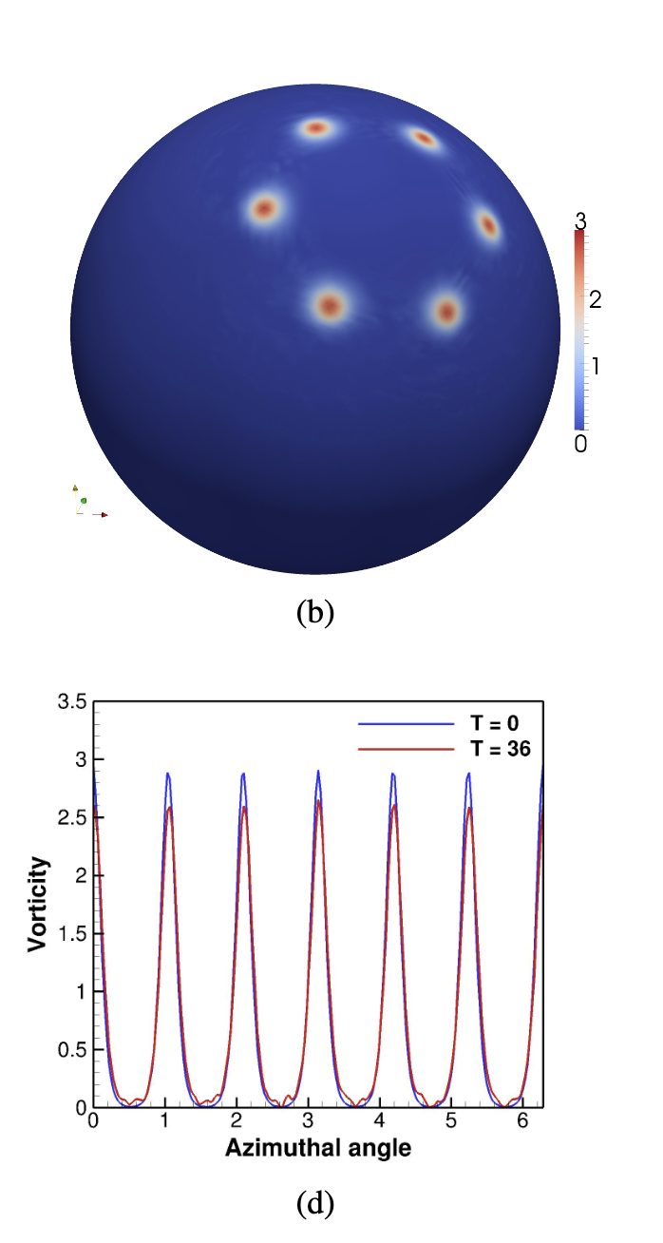
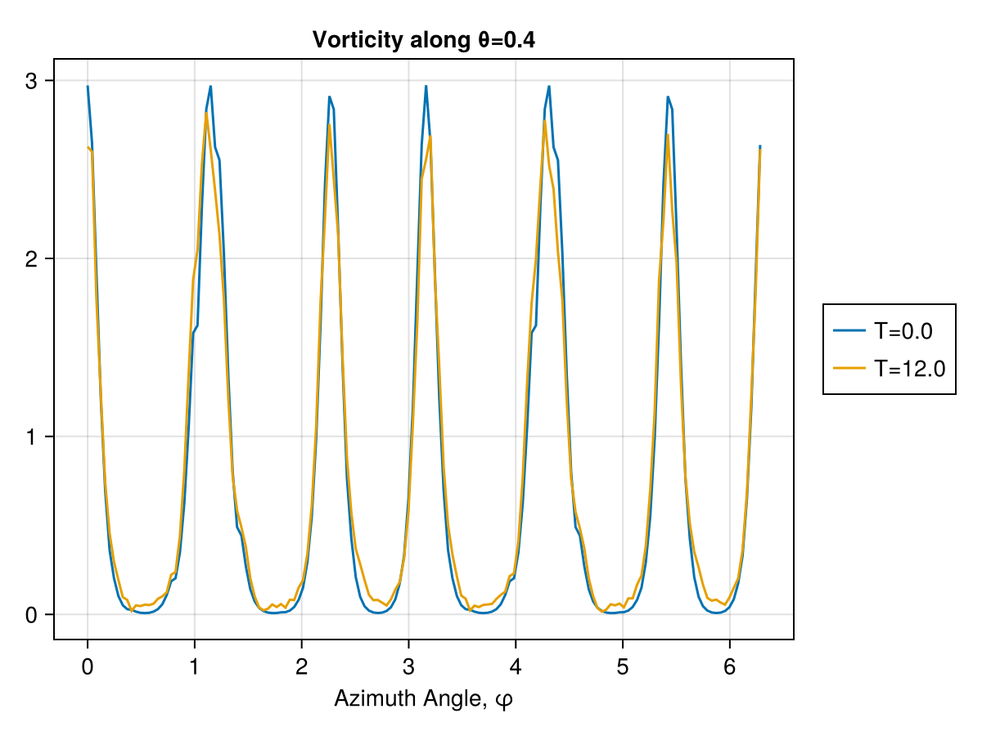
Vorticity Formulation of Incomp. Navier Stokes
eq11_inviscid_poisson = @decapode begin
d𝐮::DualForm2
𝐮::DualForm1
ψ::Form0
ψ == Δ⁻¹(⋆(d𝐮))
𝐮 == ⋆(d(ψ))
∂ₜ(d𝐮) == -1∘(♭♯, ⋆₁, d̃₁)(∧ᵈᵖ₁₀(𝐮, ⋆(d𝐮)))
end
Stable solves with nearly periodic solutions
Replicates the analysis from: Mohameda, Hirani & Samtaneya 2016

Slide 20
Conclusions
Decapodes is an advanced multiphysics simulation platform for DEC
Supports features that you expect, Multigrid, GPU acceleration
Validated against other DEC results showing similar accuracy.
Ready to support other groups in DEC research
Future Directions: Distributed Memory Parallelism, FEEC, Specialized numerics for CFD/EM

Slide 21
Custom Operators are Allowable
You can supply your own operators,
API: given a mesh, construct a matrix / linear operator that can do spMV
Can be used for specialized schemes (upwinding or WENO) or conducting DEC research.
Notes:
TODO: add example of supplying a custom operator

Slide 22

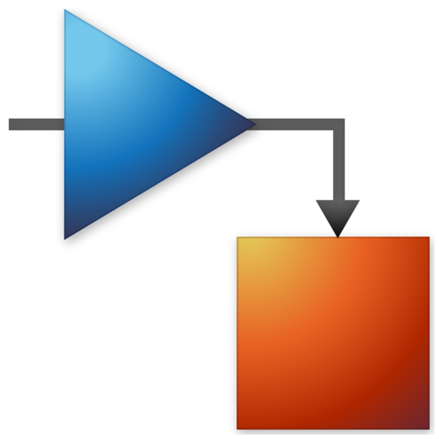





Spectrum of Scientific Computing Technology
Programs that have explicit representations of the model
Arbitrary Code
Domain Specific Languages
Computer Algebra Systems
Modeling Frameworks

Slide 23
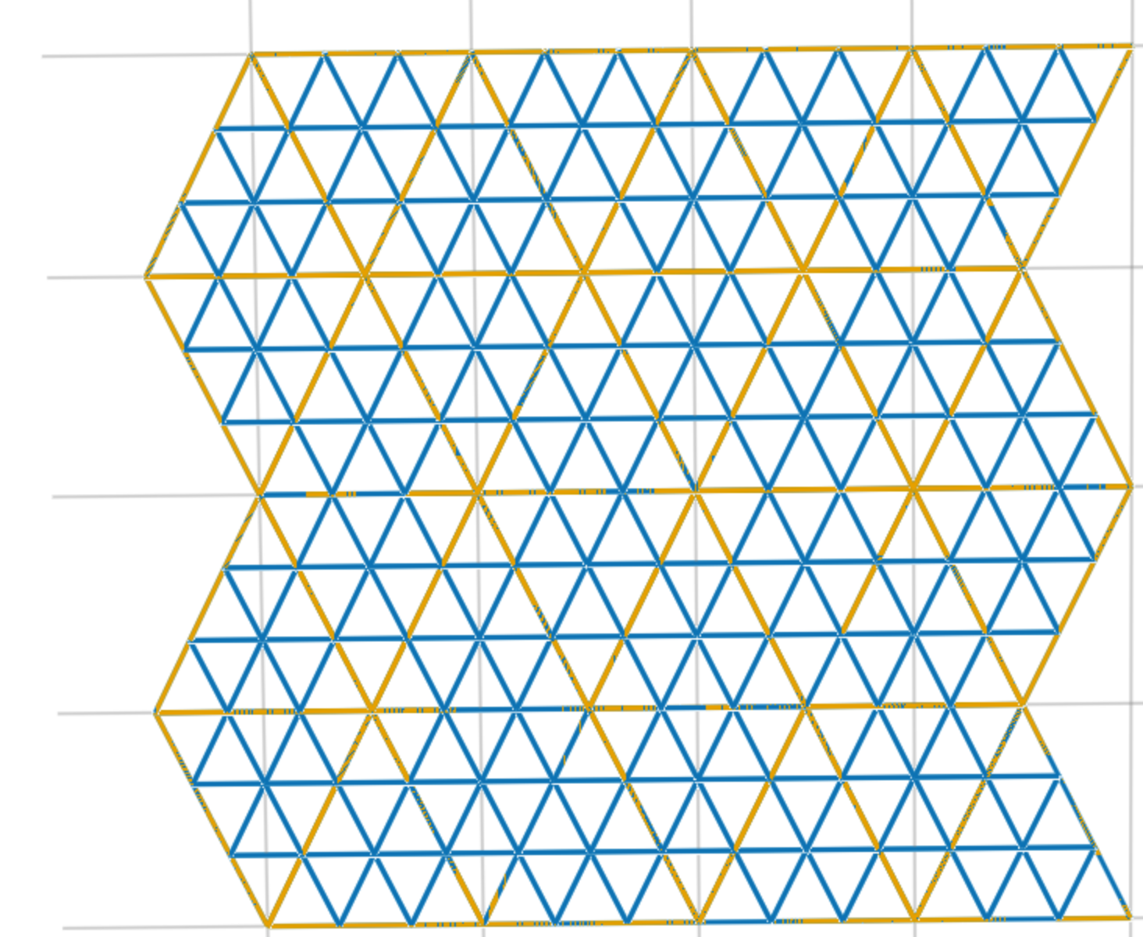
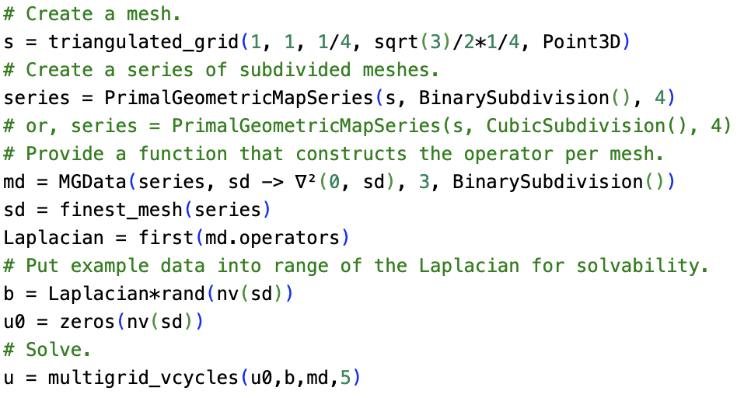
Multigrid for Laplacian Solves
Need a picture of the cubic subdivision
Usage in a fluids decapode showing how easy it is to plug in.
Notes:
Remake this image with large grid in GATAS orange and small grid in GATAS blue

Slide 24
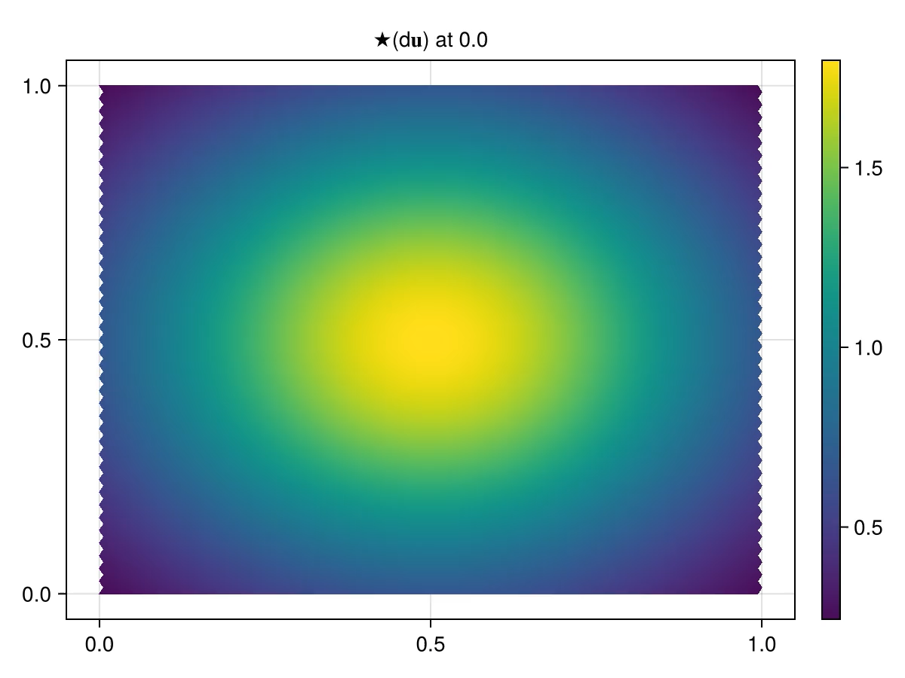
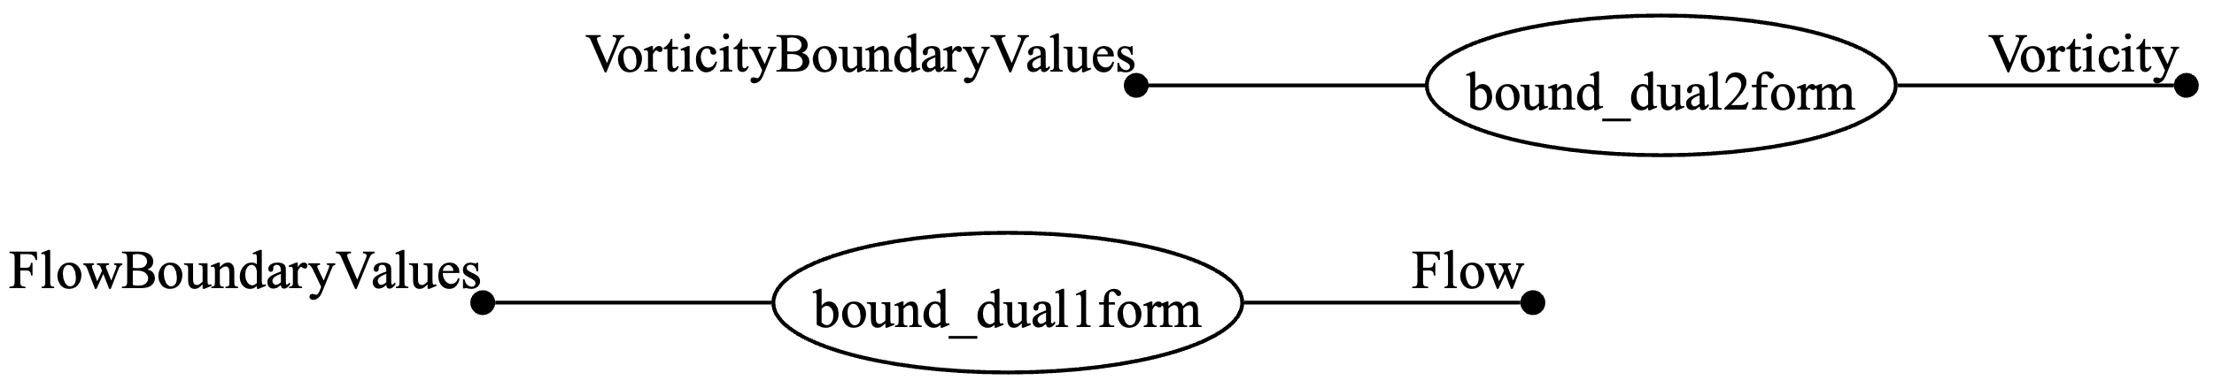
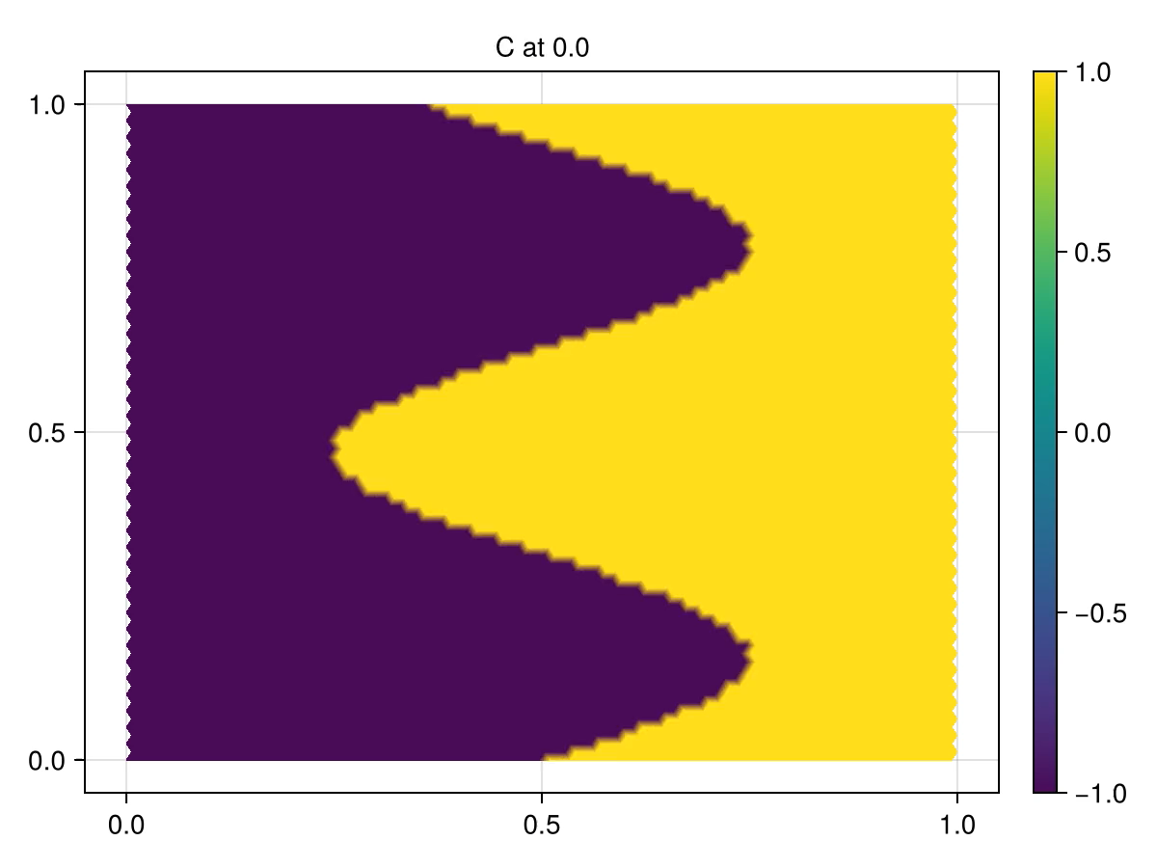
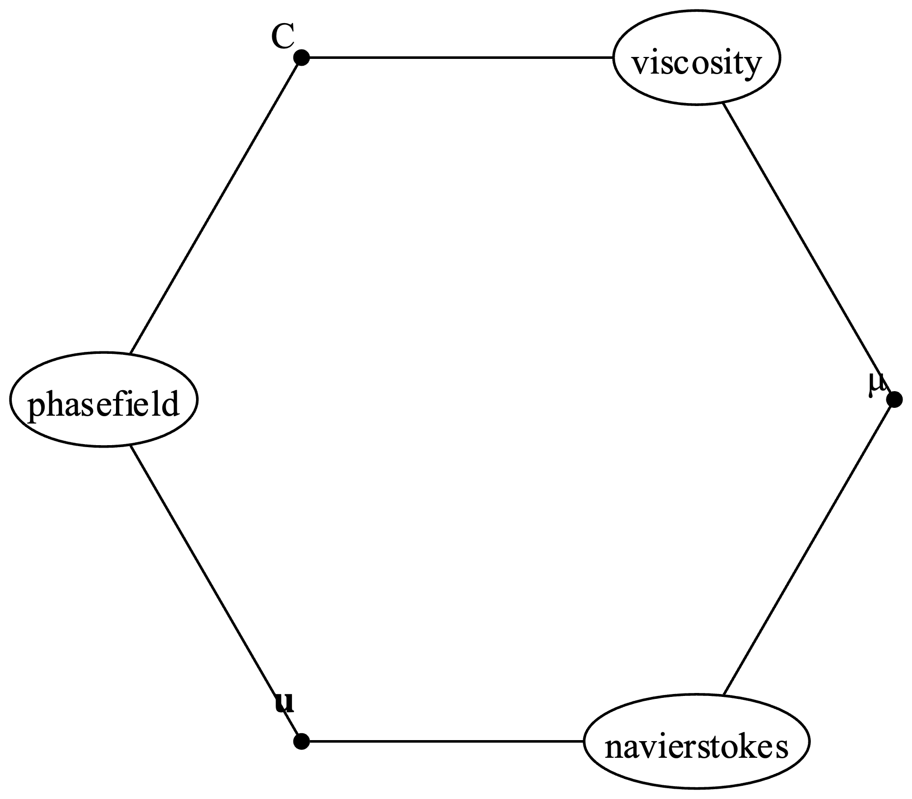
Full Scale Examples of Multiphysics
Notes:
TODO LUKE:
3 panel UWD + DEC + Results
Add Appropriate Caveats

Slide 25
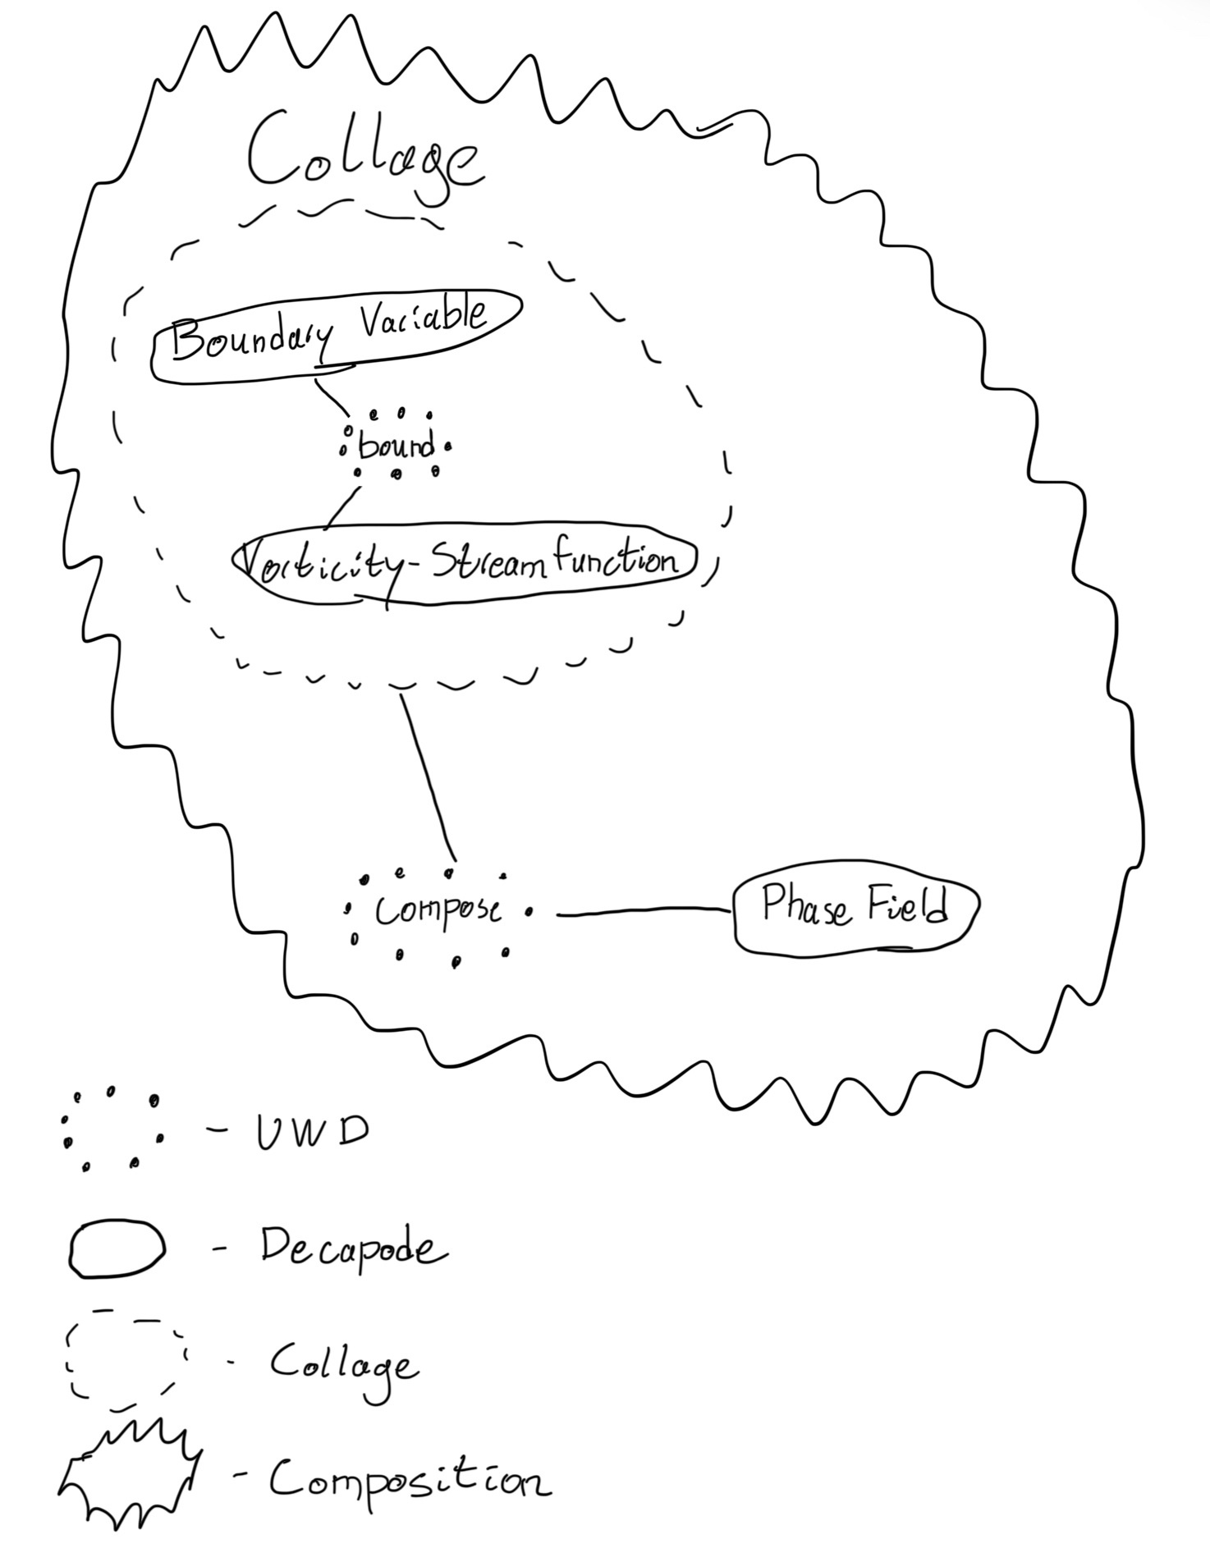
Collage Usage
Collage Quiver diagram
Notes:
TODO LUKE: add Julia code for this
TODO James: Omnigraffle this graphic
We should show how the MITRE evaluators used collages to do BCs for the eval

